Slide 1
Douglas County
Healthy Youth Coalition

Slide 2
Agenda
Meet and Greet
Activity
Prevention Basics
Coalition Basics
Next Steps

Slide 3
Personal Inventory Assessment
Multi-scale psychological assessment that identifies various personalities styles to facilitate deeper communication, understanding, and self discovery

Slide 4

Personal Inventory Assessment History
400 B.C. Hippocrates ➢ Four types
Sanguine
Choleric
Phlegmatic
Melancholic

Slide 5
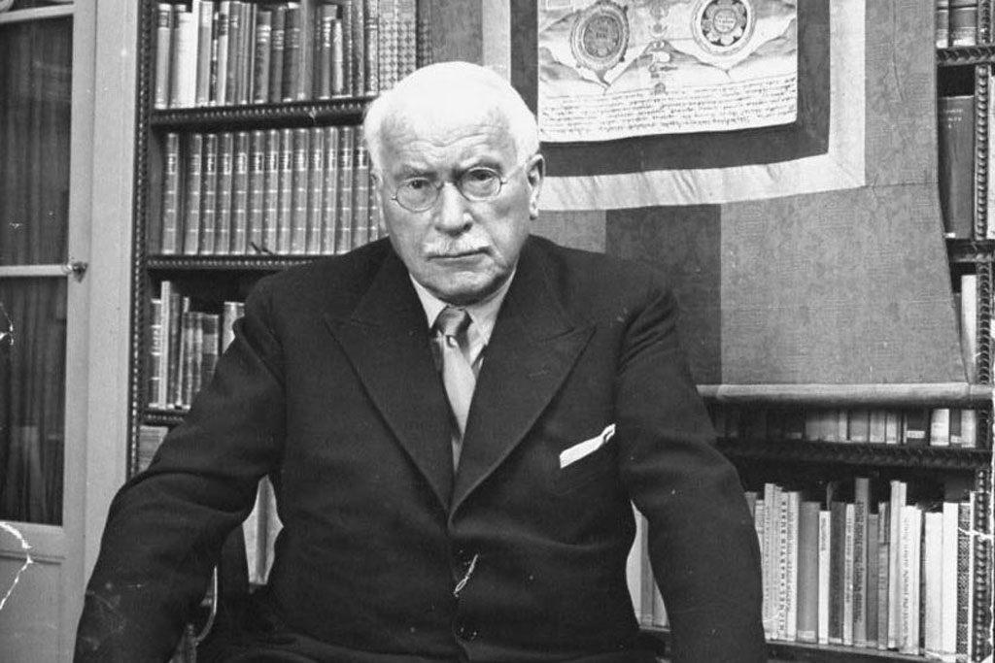
Personal Inventory Assessment History
1920’s Carl Jung ➢ Psychological Types
Thinker
Feeler
Sensor
Intuitor

Slide 6
Personal Inventory Assessment History
Katharine Cook Briggs & Isabel Briggs Myers
(Myer-Briggs Type Indicator or MBTI)
ENTP
ISTJ
ESFP
INFJ
ESTJ
ENTP
1950’s Myers - Briggs

Slide 7
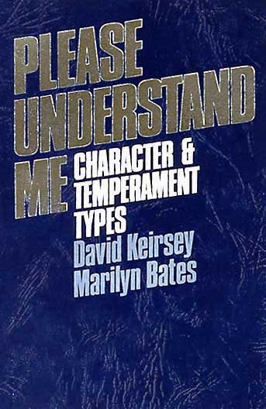
Personal Inventory Assessment History
1970’s David Keirsey ➢ Temperament Types
Apollonian
Promethean
Epimethean
Dionysian

Slide 8
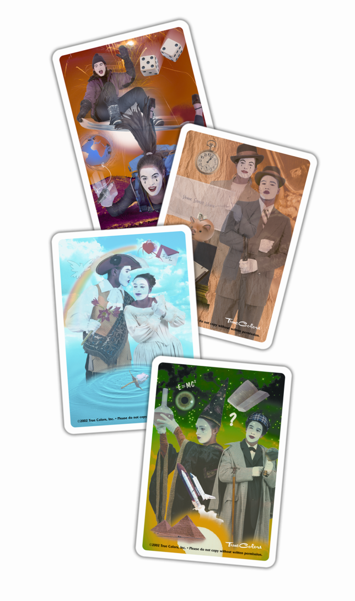
True Colors Evolution
1978 Don Lowry ➢ True Colors
Don becomes aware of the work of David Keirsey. He believed there were Fundamental and Universal applications of Keirsey’s work.
But…to remember it, it needed to be FUN!
True Colors is born.
ORANGE  GOLD  BLUE  GREEN

Slide 9



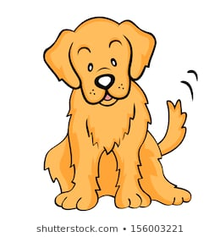

Personality Inventory Assessments
There are an number of personality assessments available, some can even be accessed for free.
Gary Smalley's personality test
  http://www3.dbu.edu/jeanhumphreys/SocialPsych/smalleytrentpersonality.htm
Notes:
Gary Smalley Personality Types Inventory (from Making Love Last Forever, Ch. 10: Understanding Personality Types: A Key to Lovability) How to Take and Score the Inventory
1. For each temperament type, circle the positive traits (in the left column) that sound the
most like you – as you are at home. It will probably help to cover the right hand
column as you take the inventory, to help you focus on the positives. Do not score
yourself as you behave at work. (If you want to evaluate your “at work” tendencies,
take the test again later, with that environment -- or any other – in mind.) For now,
ignore the right hand column.
2. For each trait, add up the number of circled traits (in the left column) and then double
that number. This is your score.
3. To graph your temperament “mix”, mark your score for each temperament type on the
graph with a large dot. If you want, draw a line to connect the dots. Lion Temperament Characteristics Likes authority. ………………...Too direct or demanding
Takes charge……………….…..Pushy; can step in front of
others
Determined. …………………... Overbearing
Confident. …………………..…. Cocky
Firm ………………………...…...Unyielding
Enterprising. ……………..….... Takes big risks
Competitive. ……………….….. Cold blooded
Enjoys challenges. …….…..…..Avoids relations
Problem solver. ………….….... Too busy
Productive. ……….……….…... Overlooks feelings; do it now!
Bold. …………………….……... Insensitive
Purposeful; goal driven…..….... Imbalanced; workaholic
Decision maker. ………….….... Unthoughtful of others' wishes
Adventurous. ………………… .. Impulsive
Strong 'willed …………………...Stubborn
Independent; self reliant ……....Avoids people; seeking help
Controlling. ……………………...Bossy; overbearing
Persistent. ………………….….. Inflexible
Action oriented. ………………...Unyielding
"Let's do it now!" Lion Score (Double the number circled): ___________ Otter Temperament Characteristics Enthusiastic. ……………….…… Overbearing
Takes risks. …………………..… Dangerous and foolish
Visionary …………………….……Daydreamer
Motivator. ……………………..… Manipulator
Energetic. ……………………….. Impatient
Very verbal. ………………………Attacks under pressure
Promoter. ………………………… Exaggerates
Friendly, mixes easily…………… Shallow relationships
Enjoys popularity…………..….…. Too showy
Fun loving. …………………..…… Too flippant; not serious
Likes variety. ………………..…… Too scattered
Spontaneous. ……………….…… Not focused
Enjoys change. ………….……..… Lacks follow through
Creative; goes for new ideas. .…..Too unrealistic; avoids details
Group oriented. ………….….…… Bored with "process"
Optimistic………………….….……Doesn't see details
Initiator. ………………….….…….. Pushy
Infectious laughter……….….…… Obnoxious
Inspirational……………….…..…. Phony
"Trust me! It'll work out!" Otter score {double the number circled}: _________ Golden Retriever Temperament Characteristics Sensitive feelings. ……..…….… Easily hurt
Loyal. ………………………….… Misses opportunities
Calm; even keeled. ……….….… Lacks enthusiasm
Nondemanding ………….…...… Weakling; pushover
Avoids confrontations. .………… Misses honest intimacy
Enjoys routine …………….…..…Stays in rut
Dislikes change. ………….….… Not spontaneous
Warm and relational. …….….… Fewer deep friends
Gives in. ……………….……...… Co-dependent
Accommodating. …….…….…… Indecisive
Cautious humor. ……….….…… Overly cautious Golden Retriever (contd) Temperament Characteristics Adaptable. ……………………..… Loses identity
Sympathetic. ………………..…… Holds on to others' hurts
Thoughtful. …………….………… Can be taken advantage of
Nurturing. …………….………..… Ears get smashed
Patient. …………………………… Crowded out by others
Tolerant. ………………….……… Weaker convictions
Good listener. …………………… Attracted to hurting people
Peacemaker. ………………….… Holds personal hurts inside
"Let's keep things the way they are." Golden retriever score (double the number circled): _____ Beaver Temperament Characteristics Reads all instructions. ….….…… Afraid to break rules
Accurate………………….………. Too critical
Consistent. ……………….……… Lacks spontaneity
Controlled. ……………….……… Too serious
Reserved …………………………Stuffy
Predictable. ……………………… Lacks variety
Practical. ………………………… Not adventurous
Orderly…………………….……… Rigid
Factual…………………….…..….. Picky
Conscientious. …………….…..… Inflexible
Perfectionistic …………….………Controlling
Discerning. ………………….…… Negative on new opportunities
Detailed. …………………….…… Rarely finishes a project
Analytical. …………………………Loses overview
Inquisitive……………………...…. Smothering
Precise. ……………………..…… Strict
Persistent …………….………...…Pushy
Scheduled. …………………….… Boring
Sensitive. ……………………...… Stubborn
"How was it done in the past ?" Beaver score (double the number circled): __________
Charting the Results L O GR B
40---------------------------------------------------------------------------------40
35---------------------------------------------------------------------------------35
30---------------------------------------------------------------------------------30
25---------------------------------------------------------------------------------25
20---------------------------------------------------------------------------------20
15---------------------------------------------------------------------------------15
10---------------------------------------------------------------------------------10
5---------------------------------------------------------------------------------5
0---------------------------------------------------------------------------------0
How did you do? Remember this isn’t a pass-fail test. This evaluation simply
shows your tendencies and traits. As you look at your charted score, you may
see a blend of all four categories. That’s fine. Or you may see two scores
significantly higher than the others. Or you may have one category that’s head
and shoulders above the other three. No none pattern is “correct.”
Now take note of the right-hand column extreme for each of your circled
characteristics. This might be how your positive traits are perceived by your
family or friends. Lions are leaders, decisive, bottom line, problem-solvers, not conversational. Otters are fun-loving, entertainers, net workers, motivators, creative, talkers. Retrievers are loving, nurturing, loyal, good listeners, encouragers. Beavers are hard-working, detailed, accurate, focused on quality.
Consciously work to become more aware of your natural tendencies. Go for a
healthy balance, tempering any extreme problem area, focus on your
strengths and learn to cultivate the strengths of less dominant personality
traits.
Some suggestions for each personality type: Lions: Be softer and more gentle and include others when making decisions. Otters: Think before you speak, and consider consequences before you act. Retrievers: Practice saying no and making firm decisions. Beavers: Learn to relax and don’t expect others to do things just like you.
For a more in depth study on personality development, please read
The Two Sides of Love, Gary Smalley and John Trent

Slide 10
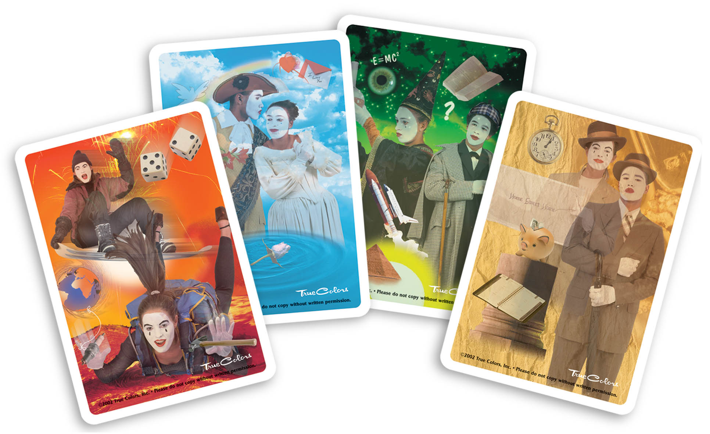

Card Sort
What Are My Colors?

Slide 11
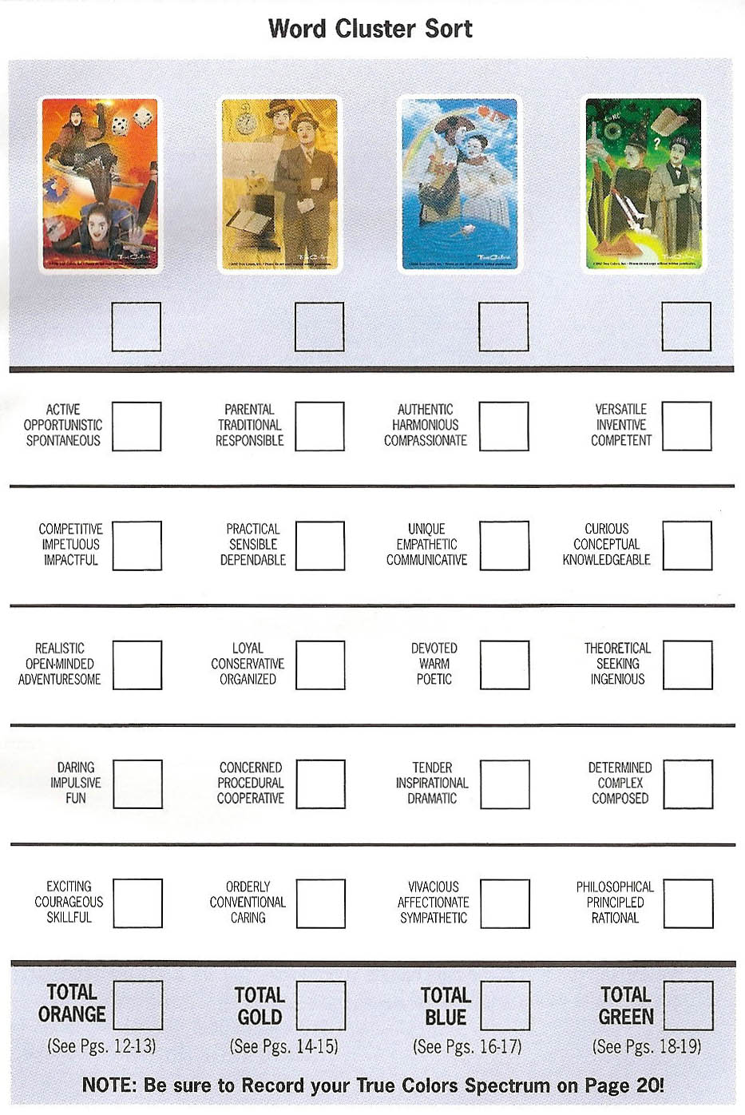
What is Your True Color Spectrum Today
#
#
#
#
Card Sort
Results

Slide 12
What is Your True Color Spectrum Today
Final Tally
#
#
#
#
#
#
#
#
Add Each Column Down
#
#
#
#
#
#
#
#
#
#
#
#
What’s My Color?
#
#
#
#
#
#
#
#

Slide 13

Core Needs & Values
Orange
Skillfulness
Freedom

Slide 14
Attributes - Orange
Playful
Energetic
Charming
Risk-taker
“Just do it”
Test limits
Quick witted
Master negotiator
Creative, inventive
“Let’s make a deal”
A natural entertainer
High need for mobility
Visual and kinesthetic
Pushes the boundaries
Natural nonconformist
Thrives on competition
Likes tangible rewards
External focus of control
Stimulates the economy
Impulsive and spontaneous
Appreciates immediate feedback
Tends to be left/right brain integrated
Most productive in informal environments

Slide 15
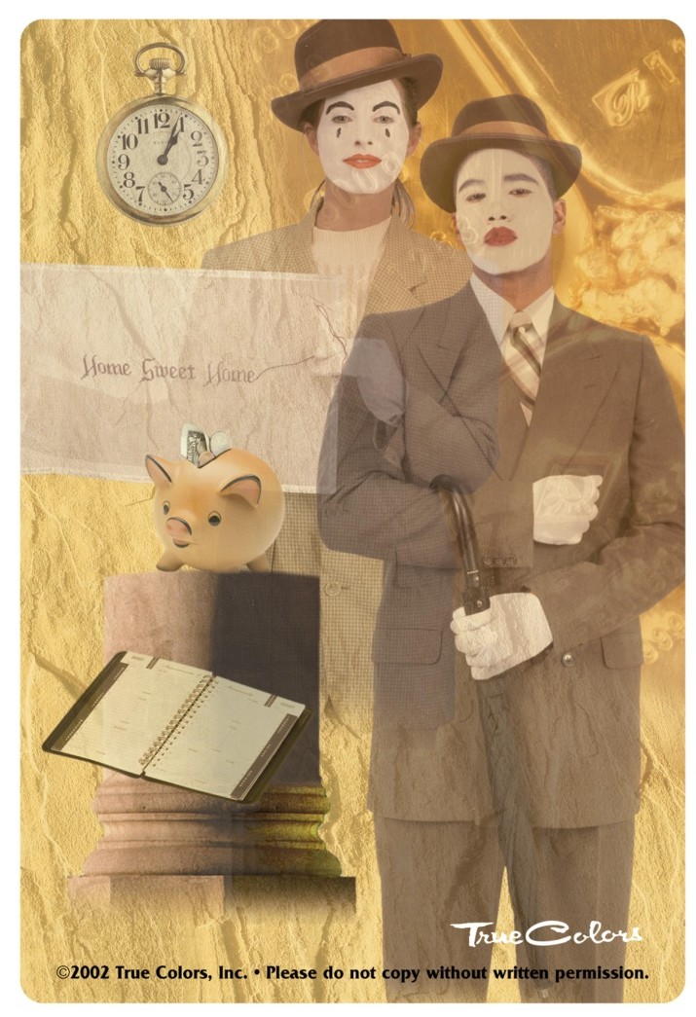
Core Needs & Values
Gold
Duty
Responsibility

Slide 16
Attributes - Gold
“Be prepared”
Loves to plan
Detail-oriented
Service-oriented
Values family traditions
Helpful and trustworthy
Conservative and stable
“Should” and “should not”
Rarely breaks the speed limit
Strives for a sense of security
Punctual, predictable, precise
Value order and the status quo
Duty, loyalty, useful, responsible
There is a right way to do everything
Tends to be left-brained and analytical
Strong belief in policies, procedures, rules
Most comfortable with a formal environment

Slide 17
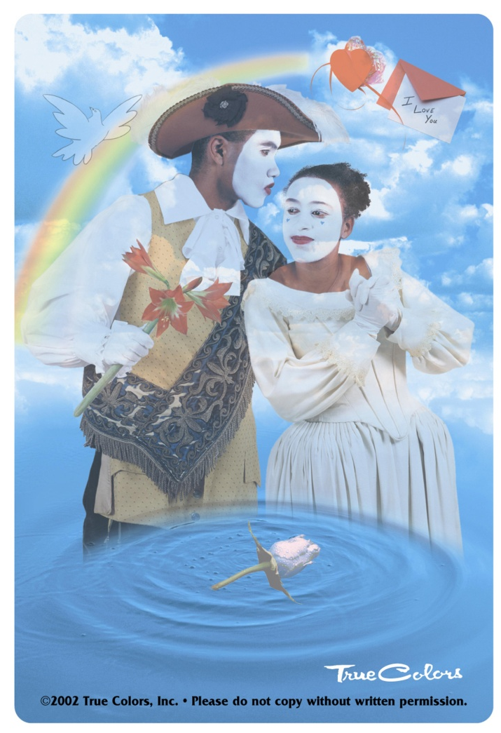
Core Needs & Values
Blue
Relationships
Authenticity

Slide 18
Attributes - Blue
Mediators
Optimistic
Caretakers
Passionate
Peacemakers
True romantics
Cause-oriented
Need to feel “special”
Always has a kind word
Enjoys symbols of romance
Strong sense of spirituality
Sensitive to needs of others
Peace, harmony, relationships
Motivate and encourage others
Cooperative rather than competitive

Slide 19
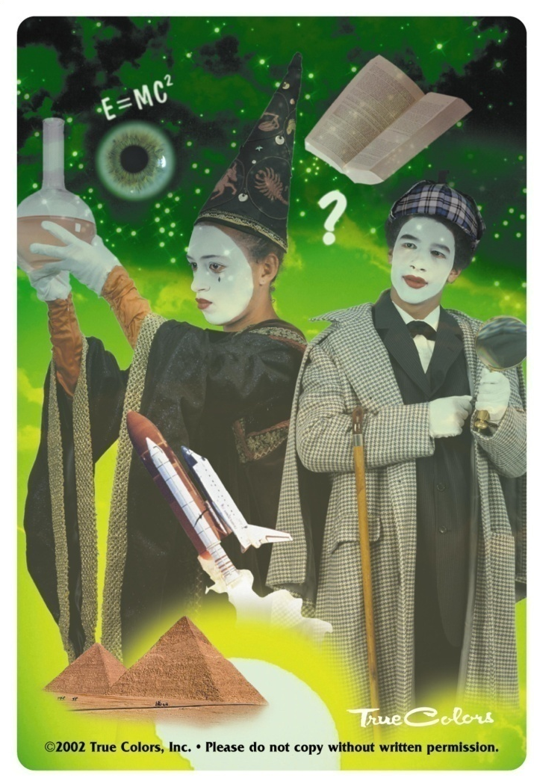
Core Needs & Values
Green
Intellectual Competence
Knowledge

Slide 20
Attributes - Green
“Should be able to”
“Why?”
Intellectual
Theoretical
Idea people
Philosophical
Very complex
Perfectionists
Standard setters
Visionaries, futurists
Can never know enough
Cool, calm and collected
Work is play - play is work
Often not in the mainstream
Abstract, conceptual, global
Need for independence and private time
Explores all facets before making decisions
Knows how to spell and pronounce “big” words
Approaches interpersonal relationships in a logical manner

Slide 21
Questions

Slide 22
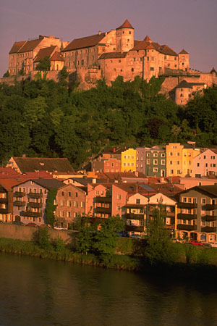
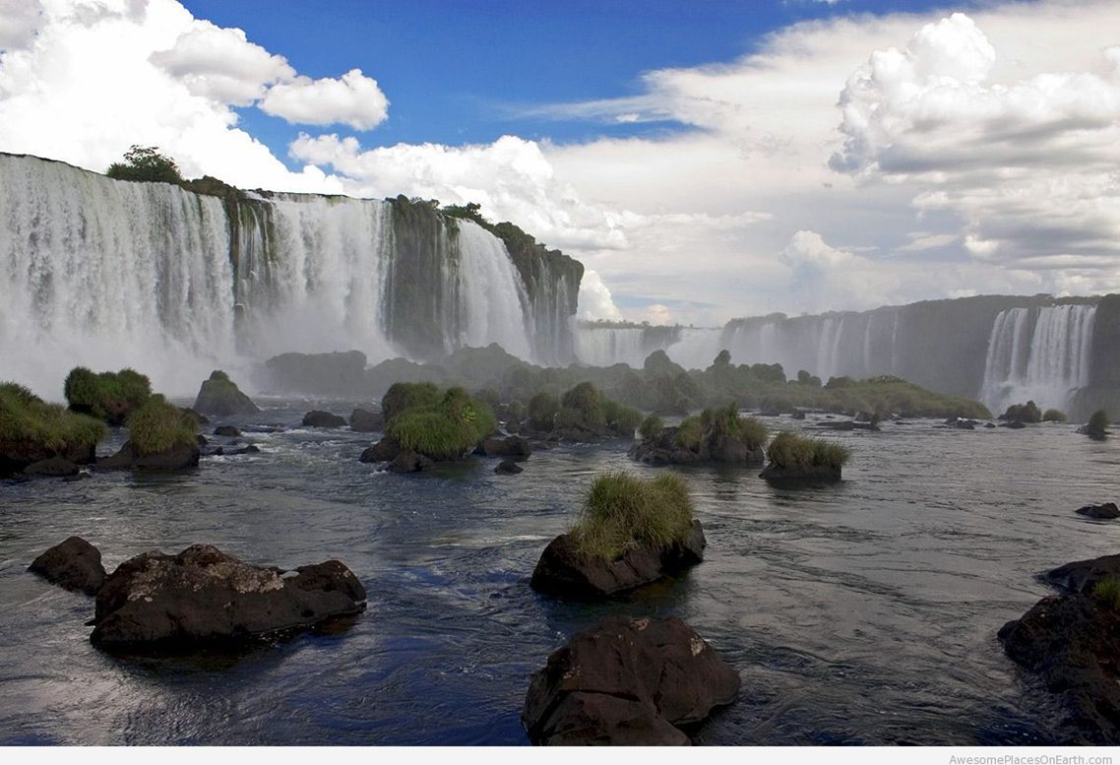
What Is Prevention

Slide 23
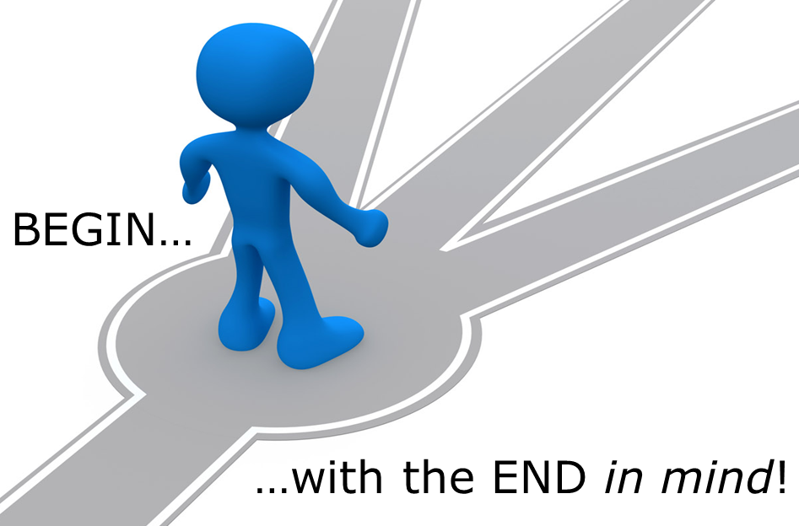
Our vision is and empowered community that promotes the health and well-being of all youth in Douglas County

Slide 24
What is Behavioral Health?
A state of mental/emotional being
and/or
choices and actions that affect wellness
Notes:
You may want to write the definition of behavioral health on easel paper so participants can refer to it throughout the training:
“A state of mental/emotional being and/or choices and actions that affect wellness.”¹
[In slideshow, clicking to this slide will cause the definition to slowly appear.]
Segue from the decades activity by making the following points:
The focus today is on behavioral health.
Substance abuse is one of many behavioral health problems. Other behavioral health problems include serious psychological distress, mental and substance use disorders, and suicide.
There are a number of problems that can be associated with substance abuse, such as mental health disorders, bullying and violence, academic failure and truancy, and teen pregnancy. In addition, the choices and actions around these other issues can also affect wellness.
Discuss the definition by asking the following questions:
What jumps out at you about this definition?
What does behavioral health mean to you?
How many of you made a healthy choice this morning? What healthy choice did you make?
What choices and actions do communities take that affect wellness?
Are all behavioral health problems preventable? (Answer: Not all of them are, such as schizophrenia.)
Refer participants to Information Sheet 1.3: Behavioral Health. This handout has the definition and additional information about behavioral health.
Make the following points:
Emotional well-being is essential to overall health. Since childhood experiences can have a lasting impact on a person’s life, promoting wellness in the early years can help “build a foundation for overall health.”²
Behavioral health services include the promotion of emotional health, the prevention of mental disorders and substance use disorders, treatment, and recovery support.³
Ask participants:
If promotion, prevention, treatment, and recovery are all part of behavioral health (which includes substance abuse and mental health), then who should we be collaborating with?

Slide 25
Continuum of Care
Treatment
Prevention
Case Identification
Indicated
Standard Treatment
Selective
Maintenance
Universal
Long-Term Treatment
Promotion
After-care and Rehabilitation
Promotion
Promotion
Notes:
Draw the continuum of care model on easel paper so that you have it to refer to throughout the training.
Refer participants to Information Sheet 1.6: The Continuum of Care.
Make the following overview statements:
This model was first presented by the Institute of Medicine in 1994 as the mental health intervention spectrum, and it was expanded in 2009 to include promotion.
The continuum of care describes the scope of behavioral health services for individuals before, during, and after they experience a behavioral health problem or disorder. It includes promotion, prevention, treatment, and maintenance.
The continuum segments the need for care and the type of care required from various parts of the health care system. This means there are multiple opportunities for addressing behavioral health problems.
The continuum underscores the interrelationship among promotion, prevention, treatment, and maintenance. While some services may be more specific, individualized, or costly than others, it shows that each phase along the continuum does not exist in isolation.
Ask participants to raise their hands if they have seen the continuum of care diagram before.
_______________
Image reprinted with permission from the National Academy of Sciences, Courtesy of the National Academies Press, Washington, D.C.

Slide 26
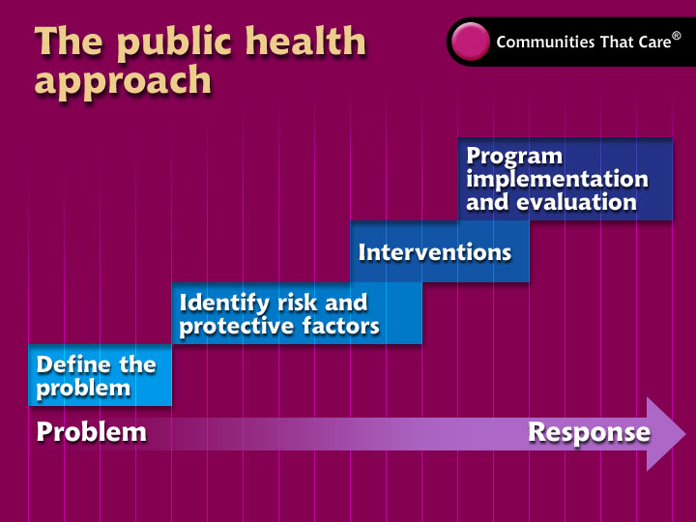

Slide 27
We can make change in two ways:
AROUND THE PERSON
INSIDE THE PERSON
Notes:
Talk about when we run programs we are affecting change inside the person. Although this is a big piece of prevention it is not the whole.

Slide 28
“The Tolstoy Principle”
Coalitions can fail for thousands of reasons but they all succeed for the same few.

Slide 29
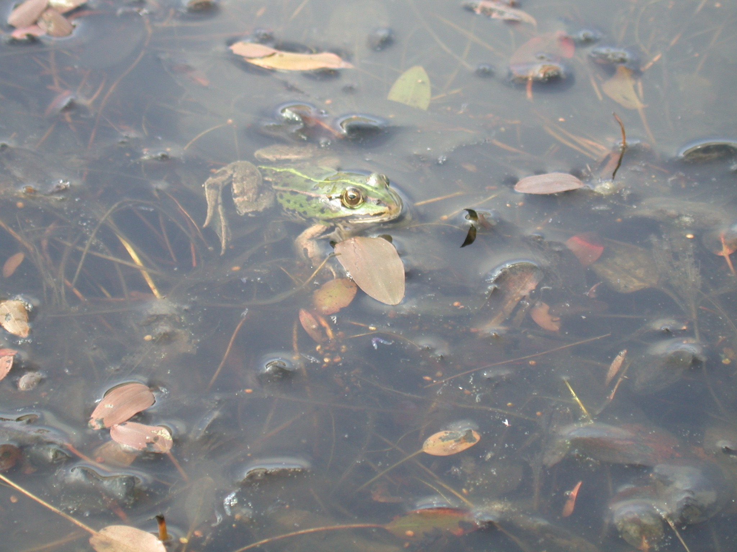
The Frog or the Pond?
Notes:
Provide participants with the following analogy:
“If the frogs in a pond started behaving strangely, our first reaction would not be to punish them or even to treat them. Instinctively, we'd wonder what was going on in the pond. We need to take this same approach when considering harmful patterns of substance use [or other problem behaviors].”*
Ask how the analogy relates to the public health model. Make sure the following points are made:
This analogy is a reminder not to focus just on individuals and changing their behavior, but to also look at the context to understand what might be influencing the problem that people experience and to determine how to make changes within that context in order to reduce the problem behavior and promote health.
This analogy segues to the next slide.
_______________
*Analogy from Centre for Addictions Research of BC, University of Victoria, 2011. Used with permission. http://www.carbc.ca/HelpingCampuses/TheoreticalFoundation.aspx
IMAGE: Imageafter.com at http://www.imageafter.com/search.php?sort_by=name_asc&color=0&display=120&search=fish (Terms of use – “CAN use our images and textures in your own work, whether it be for personal or commercial use” at http://ImageAfter.com/terms.php)

Slide 30
Our kids don't have a drug problem...
OUR COMMUNITIES HAVE A DRUG PROBLEM!!
Notes:
Short vs long term (5 min)
Ask: When is short term appropriate?
When is it not?
When you are lectured at, do you change your behavior?
Why are we more interested in PREVENTING than STOPPING? (Because that’s “prevention!”)

Slide 31
Risk Factor
A characteristic at the
biological, psychological, family, community, or cultural level
that precedes and is associated with
a higher likelihood of
problem outcomes
Notes:
Provide an anchor for risk and protective factors:
Framingham Heart Study
Dr. Dawber was the first director of the Framingham Heart Study, one of the most important research projects of the 20th century. The study, which Dawber led from 1949 to 1966, found links between vascular diseases (the leading cause of death in the United States) and diet, blood pressure, obesity, exercise, and smoking. He coined the term risk factor in 1961, and that term has now been applied to other diseases, disorders, circumstances, and events.
Segue to risk and protective factors for substance abuse with Hawkins & Catalano:
In the 1980s, Drs. David Hawkins and Richard Catalano at the University of Washington compiled risk and protective factors for substance abuse and other problems occurring in adolescence.
Ask participants to read the definition of risk factor on the slide:
“A characteristic at the biological, psychological, family, community, or cultural level that precedes and is associated with a higher likelihood of problem outcomes.”¹⁵
Refer back to the malaria example or to the fish/pond analogy, and ask participants for examples of risk factors.

Slide 32
Protective Factor
A characteristic
at the individual, family
or community level
that is associated with
a lower likelihood of
problem outcomes
Notes:
Ask participants to read the definition of protective factor on the slide:
“A characteristic at the individual, family or community level that is associated with a lower likelihood of problem outcomes.”¹⁶
Refer back to the malaria example or to the fish/pond analogy, and ask participants for examples of protective factors.
Emphasize the following:
Protective factors can reduce the negative impact of risk factors.
Resilience is the ability to recover from or adapt to adverse events, and is therefore protective.
Culture can be a protective factor. (NOTE: Unlike the definition of risk factor, this definition from the Institute of Medicine does not include a cultural level. But as the trainer, you can add this component when discussing the definition.)
Prevention is not just about eliminating a negative behavior, it is also about supporting protective factors and striving to optimize well-being.

Slide 33
Multiple Contexts
Individual
Family
Community
Society
Notes:
Point out to participants that the graphic on this slide shows the different contexts that have an influence on people’s health: individual, family, community (including school or work), and society.¹⁷ (Some participants may be more familiar with the term domains, which refers to essentially the same idea.)
Make the following points that connect to risk and protective factors:
Individuals have biological and psychological characteristics that put them at risk for, or protect them from, mental, emotional, and behavioral problems. For example, some risk factors include genetic predisposition to addiction or exposure to alcohol prenatally. Protective factors include positive self-image, self-control, and social competence.
Individuals don’t exist in isolation. They are part of families, communities, and society. Within each of these contexts, there exists a variety of risk and protective factors:
Within families, examples of risk factors include child abuse and maltreatment, inadequate supervision, parents who use drugs and alcohol or who suffer from mental illness. A protective factor would be parental involvement.
Within communities, examples of risk factors include neighborhood poverty and violence. Protective factors might include availability of afterschool activities or positive relationships with adult mentors in the community.
Within society, examples of risk factors include norms and laws favorable to substance use, as well as racism and/or lack of economic opportunity. Protective factors include policies limiting availability of substances and laws protecting marginalized populations such as LGBT youth.
Make these conclusions:
Since multiple contexts influence people’s lives, multiple interventions are necessary to reduce substance abuse and to promote emotional well-being.
Since multiple contexts influence health and well-being, it’s important to collaborate with professionals in different sectors of the community, such as education, justice, and law enforcement.
Ask participants for some examples of substance abuse prevention interventions in these different contexts.

Slide 34
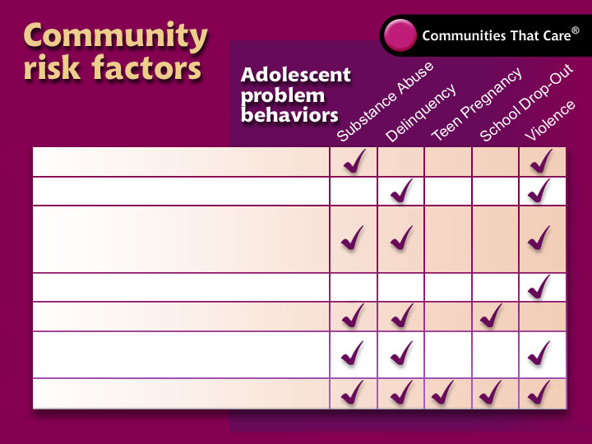
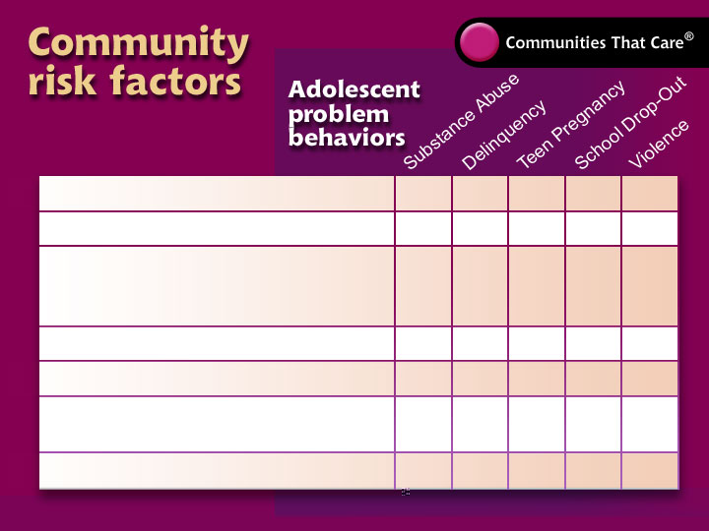
Availability of Drugs
Availability of Firearms
Community Laws and Norms Favorable toward Drug Use, Firearms and Crime
Media Portrayals of Violence
Transitions and Mobility
Low Neighborhood Attachment and Community Disorganization
Extreme Economic Deprivation

Slide 35
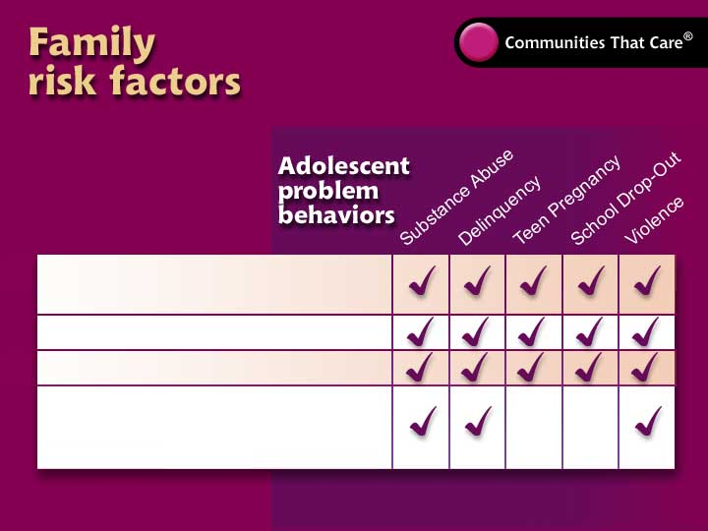
Family History of
the Problem Behavior
Family Management Problems
Family Conflict
Favorable Parental
Attitudes and Involvement
in the Problem Behavior

Slide 36
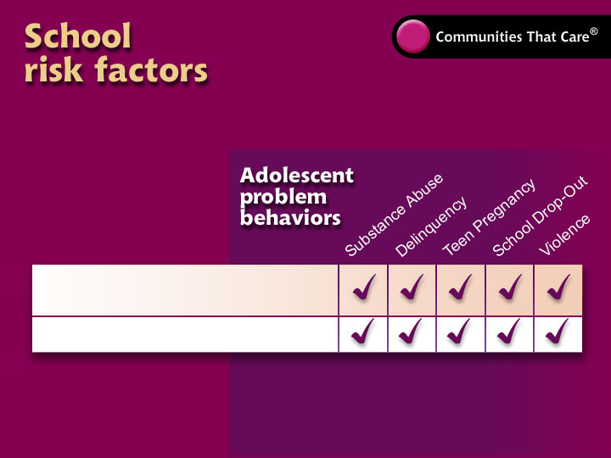
Academic Failure Beginning
in Late Elementary School
Lack of Commitment to School

Slide 37
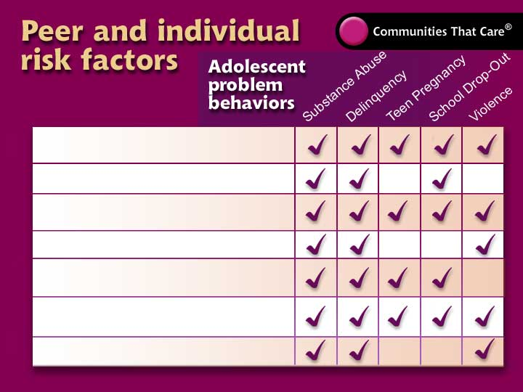
Early and persistent
antisocial behavior
Rebelliousness
Friends who engage
in the problem behavior
Gang involvement
Favorable attitudes toward
the problem behavior
Early initiation of
the problem behavior
Constitutional factors

Slide 38
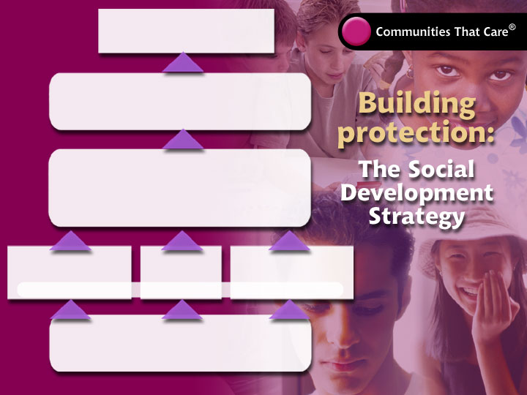

Civil Operations – Capacity and Membership
The goal…
Healthy behaviors
for all children and youth
Start with…
Healthy beliefs & clear standards
…in families, schools, communities and peer groups
Build…
Bonding
• Attachment • Commitment
…to families, schools, communities and peer groups
By providing…
Opportunities
By providing…
Skills
By providing…
Recognition
…in families, schools, communities and peer groups
And by nurturing…
Individual characteristics

Slide 39
Communities are perfectly engineered to get the results they are currently getting… this is why they should think comprehensively even if they cannot act comprehensively

Slide 40


Slide 41
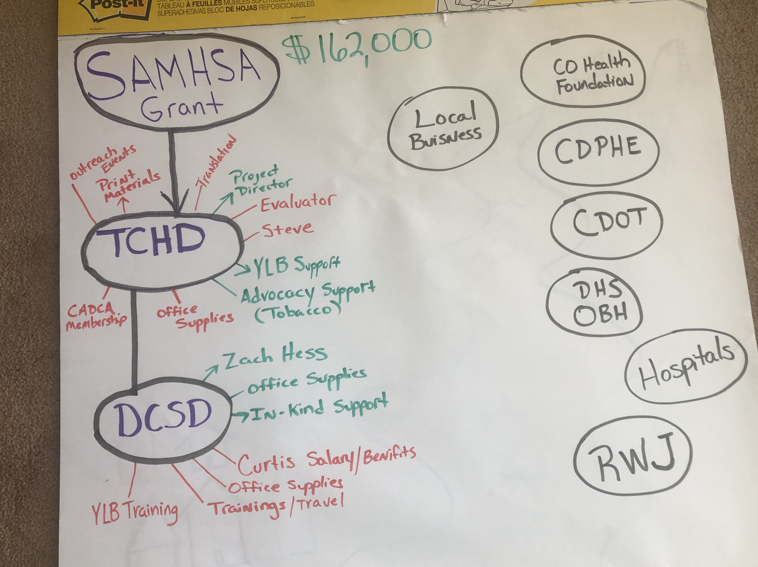

Slide 42
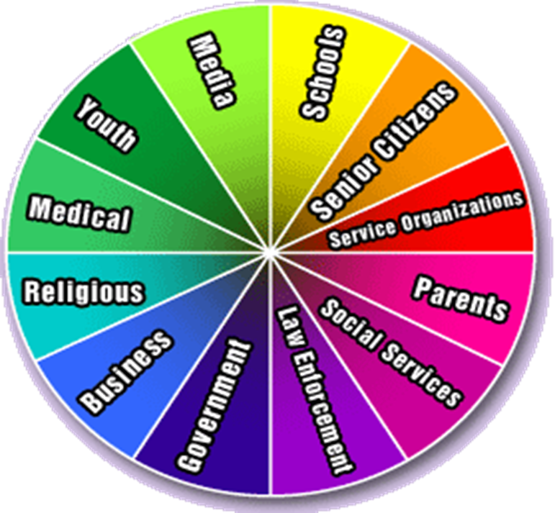
Coalition Definition
A voluntary, formal agreement and collaboration between citizens, groups or sectors of a community in which each group retains its identity but all agree to work together toward a common goal of enhancing one other's capacity, to achieve a common purpose and or goal by sharing risks, responsibilities, resources and rewards.“ – Himmelman (adapted)

Slide 43
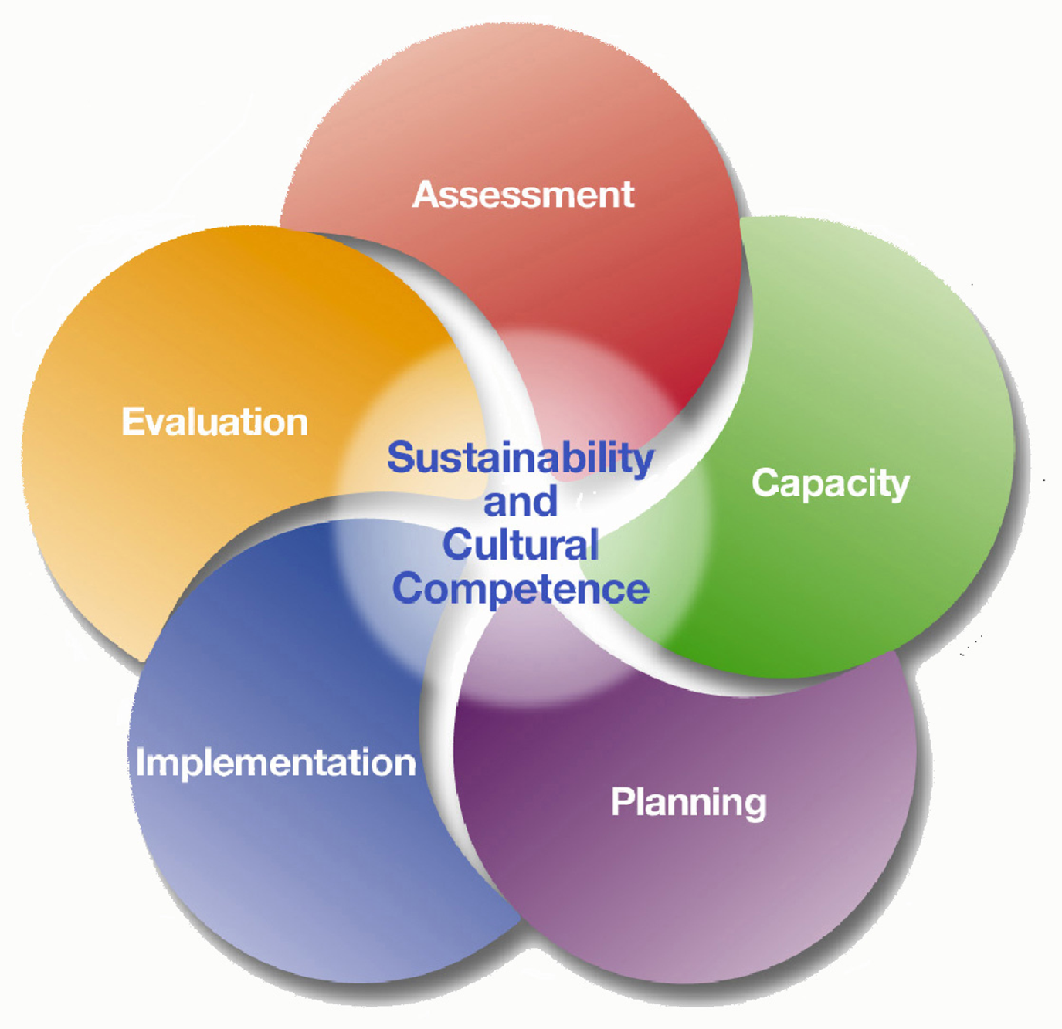
Assessment-collect data to determine the population needs, resources, and gaps.
Capacity-mobilize and/or build up resources to meet goals.
Planning-development of a comprehensive plan.
Implementation-carrying out of the plan, using evidence-based prevention programs.
Evaluation-monitoring the implementation, measuring impact, and determining needed improvements.
Always be mindful of:
Sustainability-process of integrating prevention into ongoing operations.
Cultural Competence-interacting with audiences from diverse backgrounds.

Slide 44
Skills Required to Implement the Strategic Prevention Framework
1. Create and maintain coalitions and partnerships
2. Assess community needs and resources
A. Assessment
3. Analyze problems and goals
15. Sustain projects and initiatives
4. Develop a framework or model of change
B. Capacity
14. Evaluate initiatives
5. Increase participation and membership
E. Evaluation
6. Build leadership
13. Write grant applications for funding
7. Enhance cultural competence
12. Influence policy development
11. Advocate for change
8. Improve organizational mgt. and development
10. Develop interventions
C. Planning
D. Implementation
9. Develop strategic and action plans
The relationship between SAMHSA’s Strategic Prevention Framework and the Core Competencies*

Slide 45
Best Processes¹ for Implementing
the Strategic Prevention
Framework
1. Analyzing Information About the Problem,
1. Analyzing Information About the Problem,
Goals, and Factors Affecting Them
Goals, and Factors Affecting Them
A. Assessment
2. Establishing Vision and Mission
2. Establishing Vision and Mission
12. Documenting Progress and
B. Capacity
10. Documenting Progress and
Using Feedback
Using Feedback
3. Defining Organizational Structure
11. Making Outcomes Matter
3. Defining Organizational Structure
11. Making Outcomes Matter
and Operating Mechanisms
and Operating Mechanisms
E. Evaluation
4. Assuring
Technical Assistance
9. Assuring
5. Developing Leadership
10. Sustaining the Work
7. Developing Leadership
12. Sustaining the Work
9. Implementing Effective
6. Arranging Resources for
8. Implementing Effective
6. Arranging Resources for
Interventions
Community Mobilization
Interventions
Community Mobilization
C. Planning
D. Implementation
7. Developing a framework or
4. Developing a framework or
model of change
model of change
¹Best processes identified through a literature review conducted by Dr. Renee Boothroyd, University of Kansas – used with permission.
8. Developing and Using
5. Developing and Using
Strategic and Action Plans
Strategic and Action Plans

Slide 46
Products Your Community Needs to Create
A. Community Assessment
E. Sustainability Plan
B. Logic Model
C. Strategic & Action Plan
D. Evaluation Plan

Slide 47

Decision Items
Future leadership team meetings?
Committed team members wanting to go the CADCA Forum in February 2020?
Leadership team vote on volunteers
Support “in plain sight” parent education resource
Youth leadership camp interest?

Slide 48
Community Assessment – Next Steps
Community Assessment
  Community Definition
  Community History
  Needs Assessment
  Resource Assessment
  Problem statement
  Readiness Assessment

Slide 49
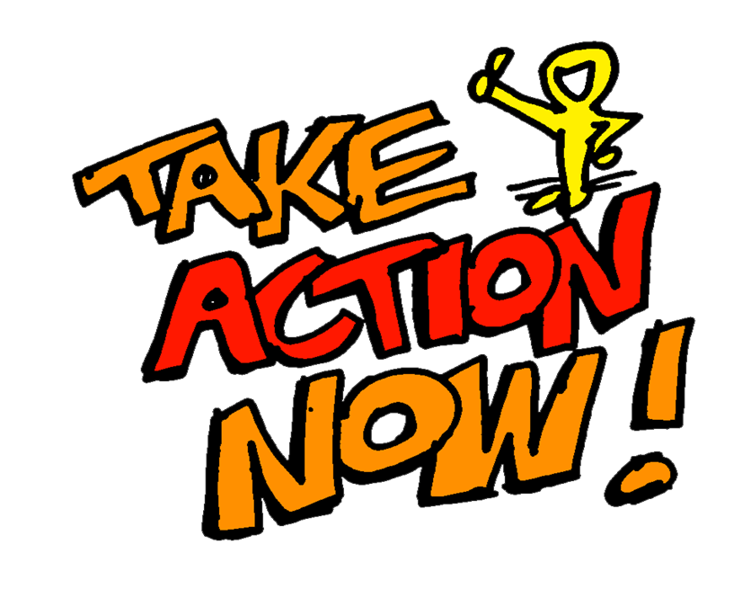
Leadership Team Deliverables– Next Steps
Learn and contribute to WorkStation
Solidify coalition bylaws document
Complete Member agreements
Recruit new members
  Identify passionate people or organizations (Health)
  Identify funders
  Connect youth groups
  Communications/Web support
  Faith community

Slide 50
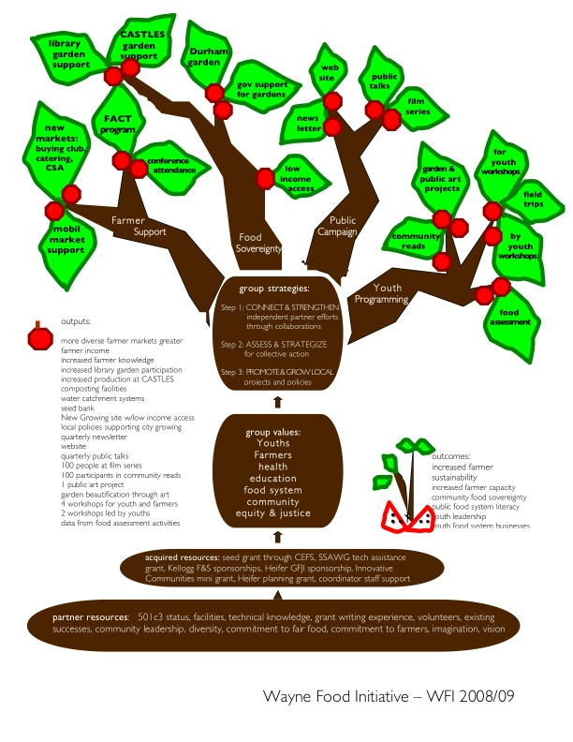
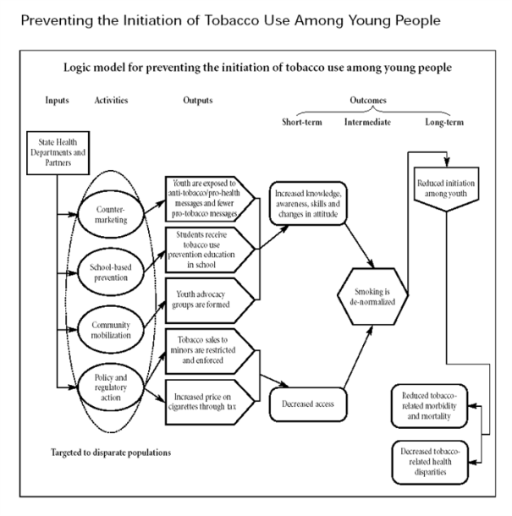
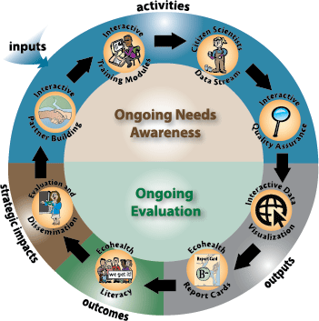
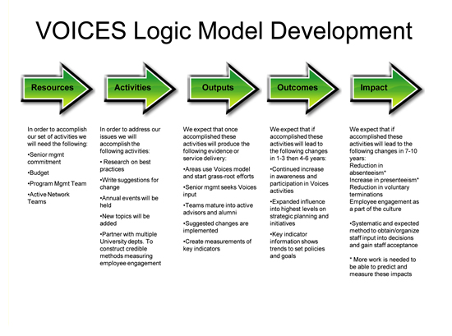
Time to build a logic model!
Representational
Metaphorm

Slide 51
Seven behavior change strategies
Provide Information
Build Skills
Provide Support
Enhance Access / Reduce Barriers
Change Incentives / Disincentives
Change Policies or Regulations
Change the Physical Design of the Environment

Slide 52

CONDITION
CONDITION
CONDITION
CONDITION
CONDITION
CONDITION
CONDITION
CONDITION
CONDITION
Notes:
Conduct short conditioning exercise.
Talk about how prevention is not only about convincing youth not to use drugs, but setting up conditions to keep it from becoming an issue.

